Slide 1
Query Processing and Evaluation
Advanced DBMS (IGNOU MCS 043 )
Block 2 – Unit 1

Slide 2
Agenda
Query Processing
Select, sort and join operations
Query Expressions
Evaluation Plans
Materialized view

Slide 3
Query Processing
Parsing and Translation
Check syntax and grammar
Translate SQL query into relational algebraic expression
Optimization
Generate an optimal evaluation plan (with lowest cost) for the query plan using statistics about the data
Evaluation
The query-execution engine takes an (optimal) evaluation plan, executes that plan, and returns the answers to the query

Slide 4
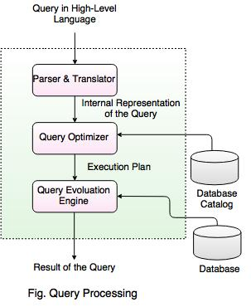
Query Processing

Slide 5
Query Optimization
SQL Query
SELECT salary FROM emp
WHERE salary < 5000;
Relational algebraic expression
σ _{(salary < 5000)} (π_{salary} (EMP))
π_{salary} (σ_{salary <5000} (EMP))
Notes:
If the emp table has 10,000 records and there are only 400 records in which salary is less than 5000.
First relational exp will first project the salary column with 10,000 records and then apply the where condition on it
Second relational exp will first pick 400 records and then project salary column.
Both queries fetch the same output, but cost are different.
Query optimization means to chose the plan with lowest cost.

Slide 6
Transformation of SQL into RA
Relations: EMP(ENO, ENAME, TITLE) ASG(ENO,PNO,RESP,DUR)
Query: Find the names of employees who are managing a project for more than 37 weeks
SELECT ENAME FROM EMP,ASG
WHERE EMP.ENO = ASG.ENO AND DUR > 37
π_{ENAME} ( σ_{DUR>37 ∧EMP.ENO =ASG.ENO} (EMP × ASG))
π_{ENAME} (EMP ⋊⋉_{ENO} ( σ_{DUR>37} (ASG)))
Notes:
Expression 2 avoids the expensive and large intermediate Cartesian product, and therefore typically is better
http://www.exploredatabase.com/2014/09/query-processing-in-database.html

Slide 7
Query Cost
Total elapsed time for answering the query
Factors are:
disk accesses, CPU time and network communication
Measured as
Number of seeks * average-seek-cost
Number of blocks read * average-block-read-cost
Number of blocks written * average-block-write-cost
"Cost to write a block is greater than cost to read a block” data is read back after being written to ensure that the write was successful
Notes:
Disk access is a predominant cost.
Magnetic disk where the head has to move to the correct cylinder where the records can be picked. This is called seek.

Slide 8
Query Cost
For simplicity we just use number of block transfers from disk as the cost measure
We ignore the difference in cost between sequential and random I/O for simplicity. We also ignore CPU costs for simplicity
Costs depends on the size of the buffer in main memory
Having more memory reduces need for disk access
Amount of real memory available to buffer depends on other concurrent OS processes, and hard to determine ahead of actual execution
We often use worst case estimates, assuming only the minimum amount of memory needed for the operation is available
Real systems take CPU cost into account, differentiate between sequential and random I/O, and take buffer size into account
We do not include cost to writing output to disk in our cost formulae

Slide 9
Selection Operation
File Scan
Linear Search
Binary Search
Index Scan
Primary Index
Clustering Index
Secondary Index

Slide 10
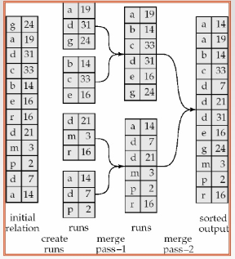
Merge Sort
Notes:
Create sorted partitions -> Merge partitions
https://www.youtube.com/watch?v=ZRPoEKHXTJg

Slide 11
Join Operations
Nested-loop join
Block nested-loop join
Indexed nested-loop join
Merge-join
Hash-join
Complex join

Slide 12
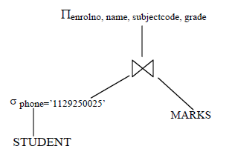
Query Tree
π_{enrolno, name, subjectcode} ( σ _{phone=’1129250025’} (STUDENT) MARKS)

Slide 13
Methods of evaluation
Materialization
Bottom-up evaluation
Storing results of each operation
Cost of rw operations are high
Pipelining
Multi-threaded operation
Results of an operation are passed to the next operation
A buffer may be used to store temporary results
It may not always be possible

Slide 14
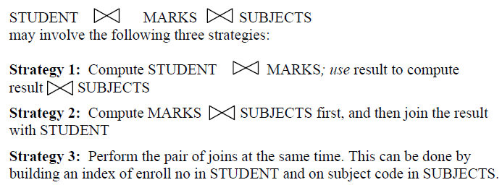
Complex Joins

Slide 15
Cost Based Optimization
Generating logically equivalent expressions using equivalence rules
Annotating resultant expressions to get alternative query plans
Choosing the cheapest plan based on estimated cost.

Slide 16
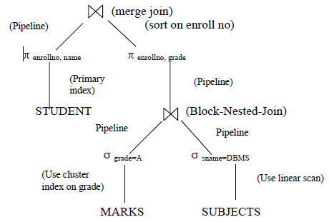
Query Evaluation Plans
A plan that defines the algorithm to be used for each operation in a query tree.

Slide 17
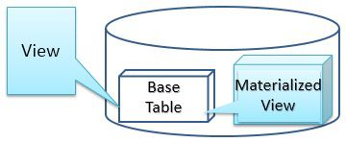
Materialized Views
View | Materialized View
It is never stored physically. Only definition is stored | It is stored on the disk
Virtual table, made up of one or more base tables | Physical copy of the base table
Automatically updated when base table gets changed | Has to be updated manually
Slow processing | Fast processing

Slide 18
Thank You

